Slide 1
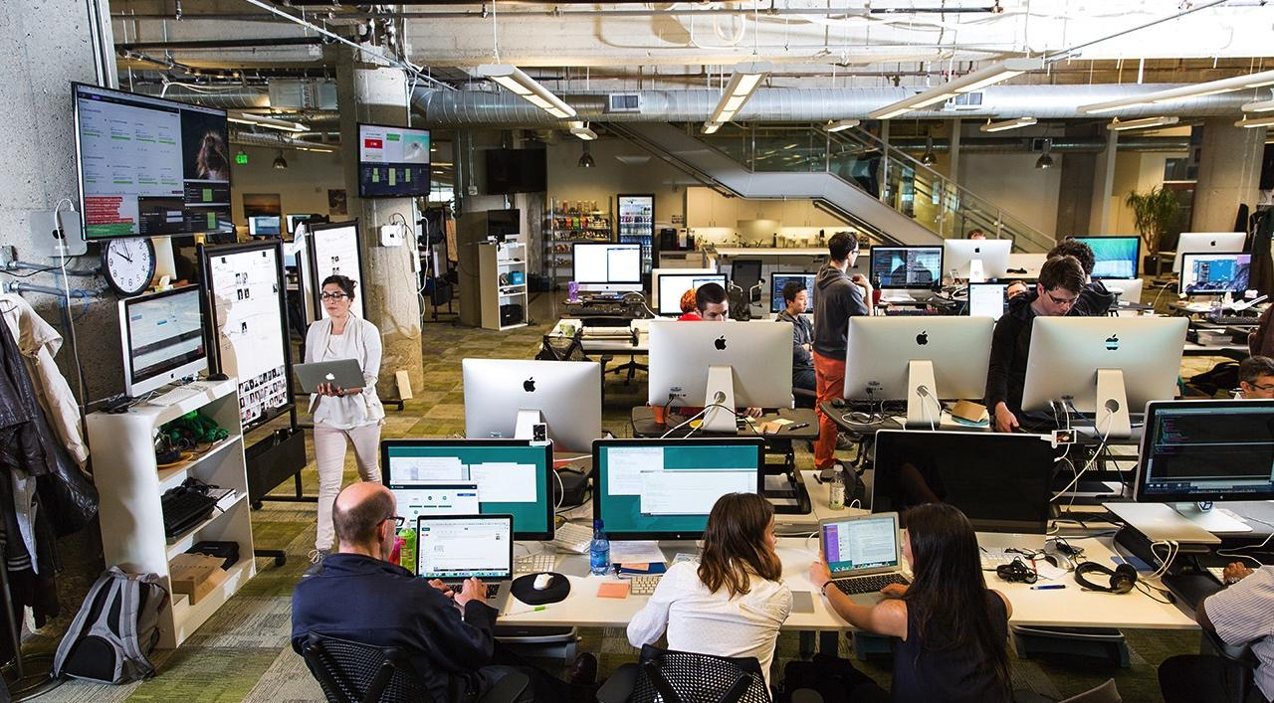

Building the world’s most successful software businesses
Dan Kennedy, Executive Lead, Strategic Partnerships

Slide 2
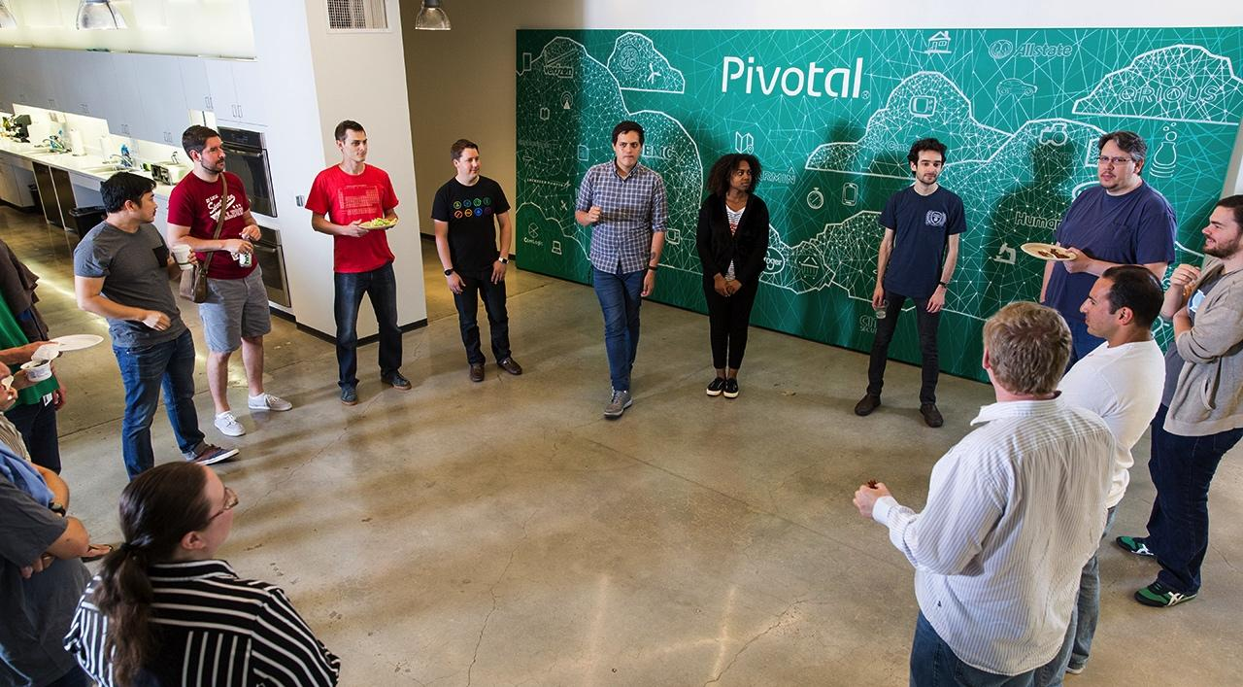
Our mission is to transform how the world builds software

Slide 3

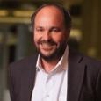













1990
Discover
An agile, rapid iteration, test-driven approach to software development
2000
Implement
New methodologies to influence software development culture of Silicon Valley’s most influential internet companies
2013
Accelerate
The transformation of the world’s largest companies with modern software development methods and cloud platform
2016
Transform
The world’s largest companies into cloud native software companies
Rob Mee
Paul Maritz
Scott Yara
Bill Cook

Slide 4
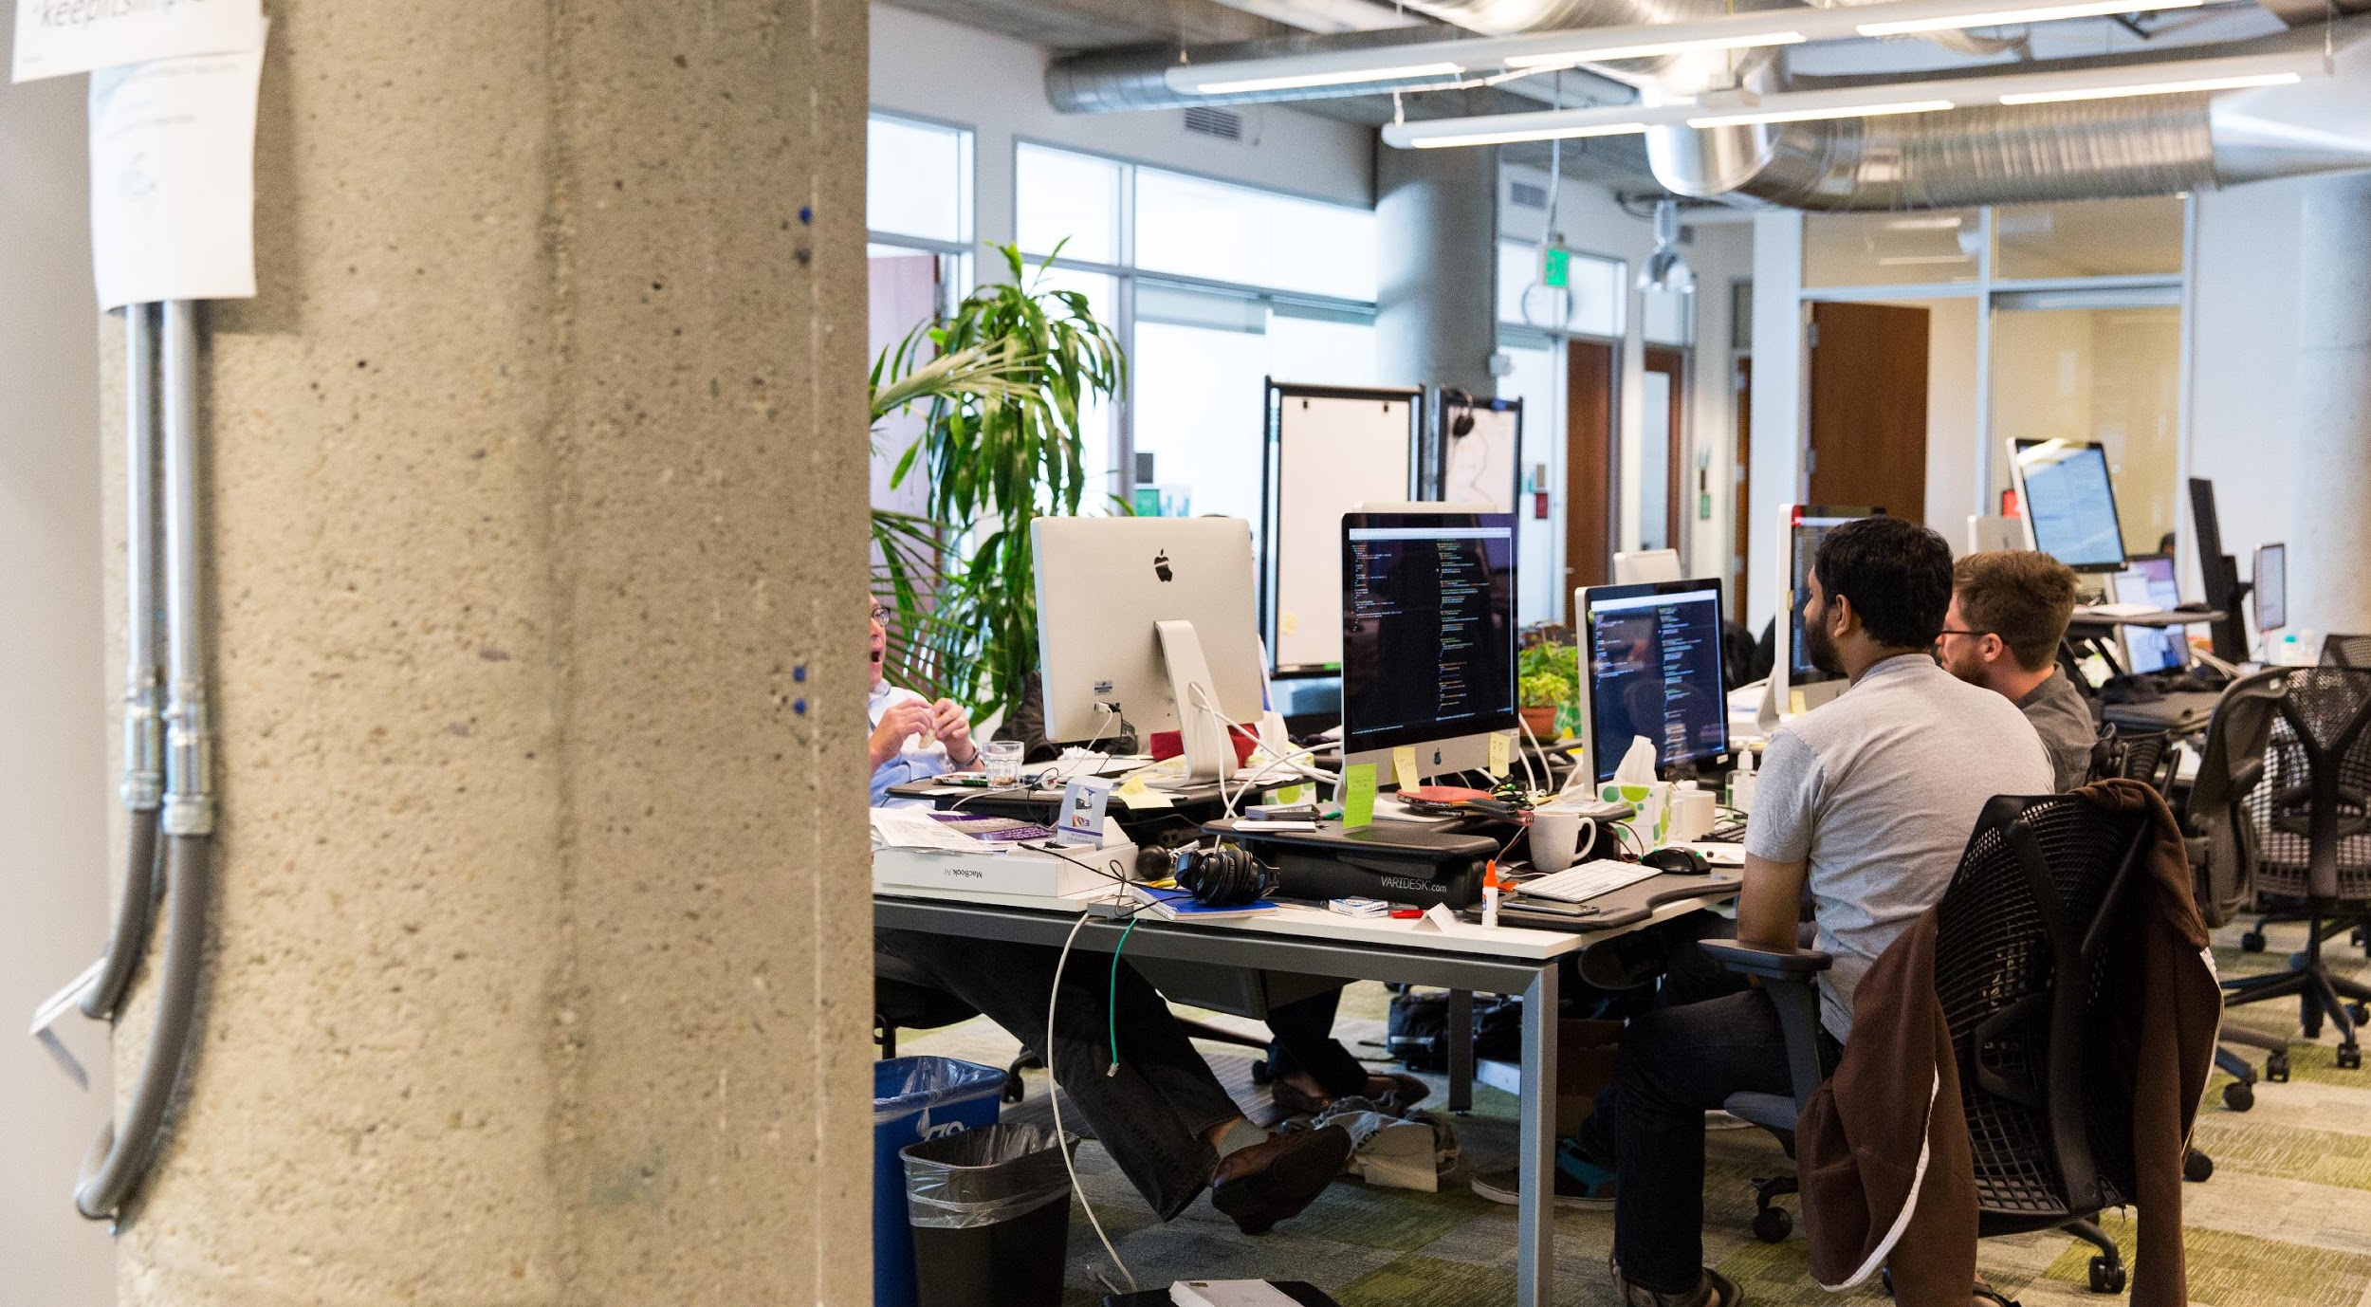





KEY TRENDS
The cost and ubiquity of computing enables cloud native software companies to reshape the world
Mobile devices and connectivity
Near-free computing costs
Global scale of operations
Ubiquity of embedded sensors

Slide 5

The drivers of transformation are fear and hope
Fear of Disruption
Hope of Transformation

Slide 6

Fear of being disrupted
“Silicon Valley is coming...”
Jamie Dimon
CEO, JPMorgan Chase
Source: JPMorgan Chase Annual Shareholder Letter (2015)

Slide 7










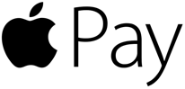

Slide 8

Lightening fast and agile
These software companies are capable of releasing new features:
In minutes
Multiple times a day
At enormous scale
Around the world

Slide 9

Hope of transformation
“If you went to bed last night as an industrial company, you’re going to wake up a software and analytics company.”
Jeff Immelt
CEO, General Electric
Source: User Summit (2014)

Slide 10


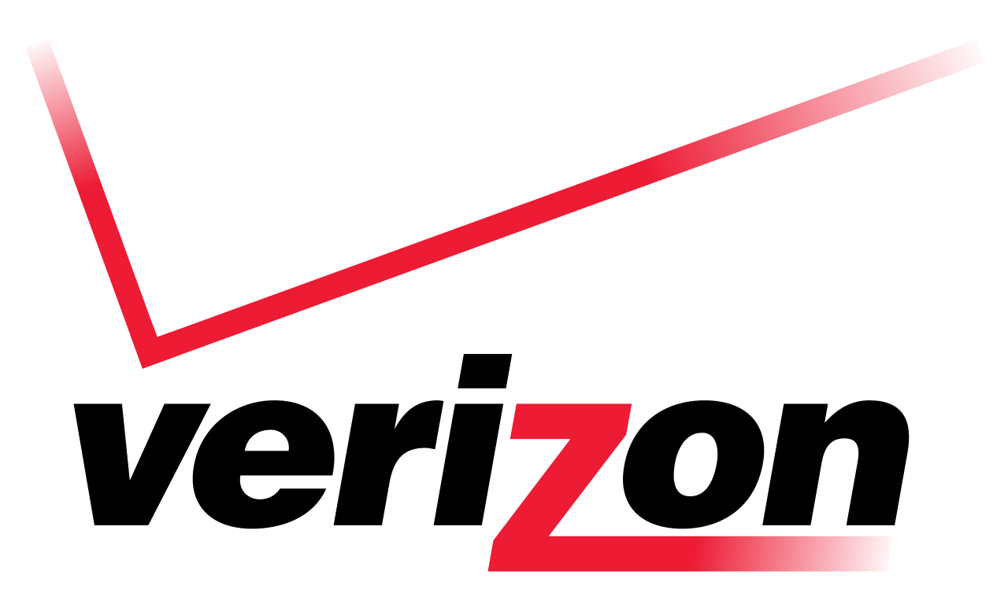
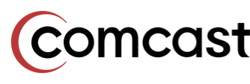


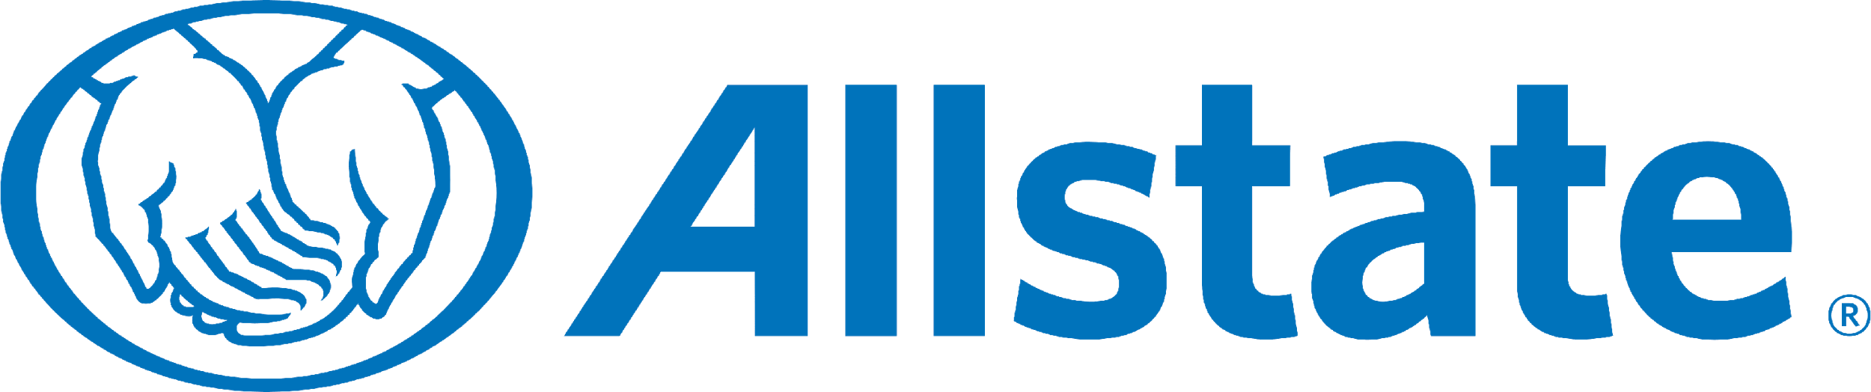




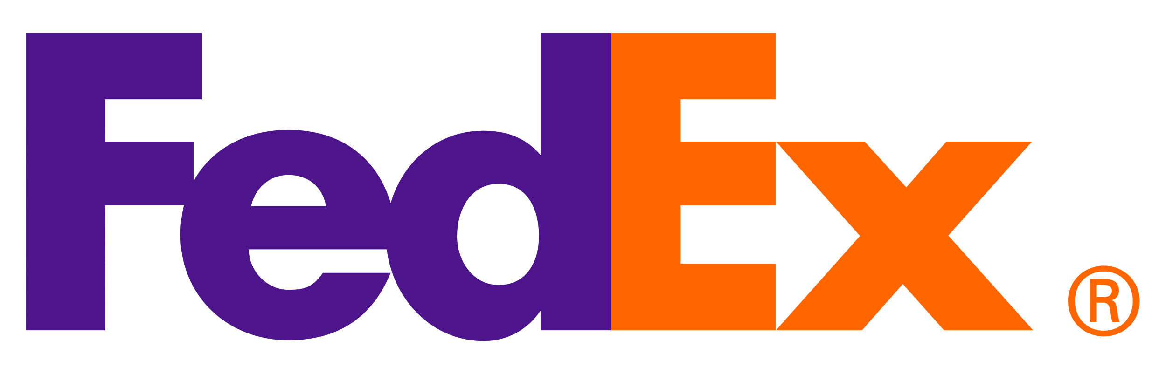

Slide 11
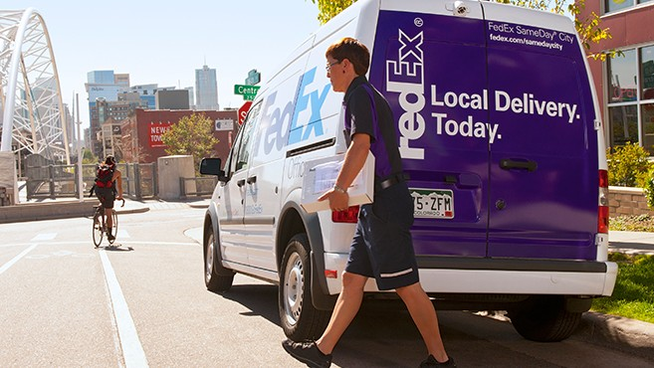
“Technology is the backbone of how we operate the company, from delivering ten million plus packages each day, to how we interface with our customers; it is all technology based.”

Slide 12
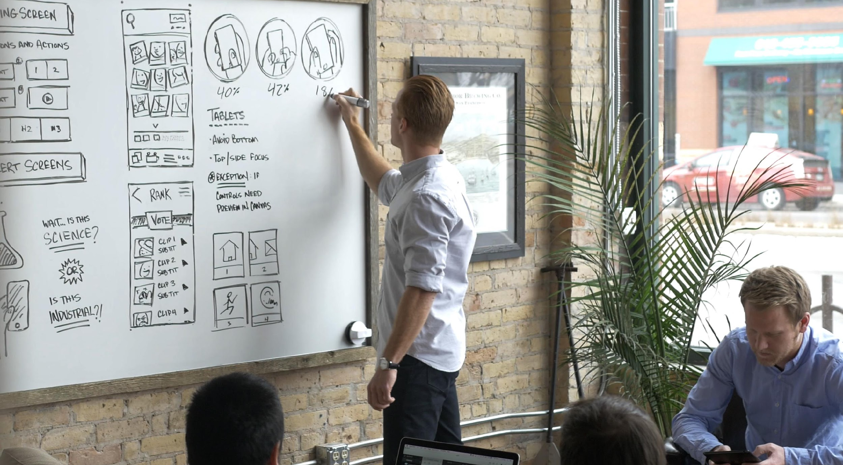
On average, large IT projects deliver
75%
56%
of application development
supporting digital business
will be built not bought by 2020
less value than predicted.
Source: McKinsey & Company with the University of Oxford
Source: Gartner

Slide 13

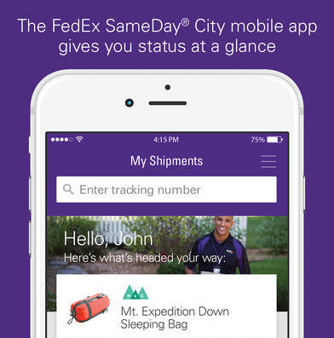
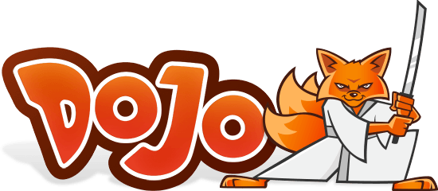


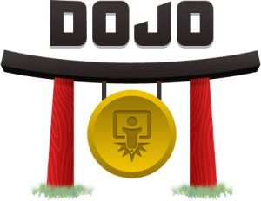



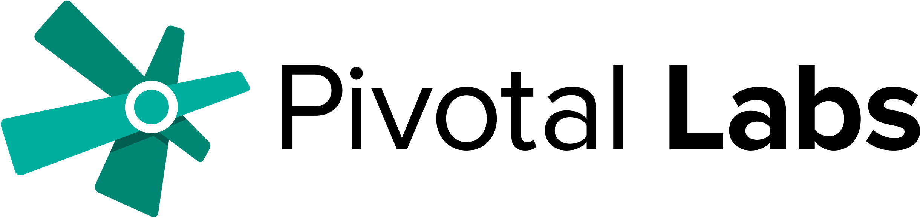
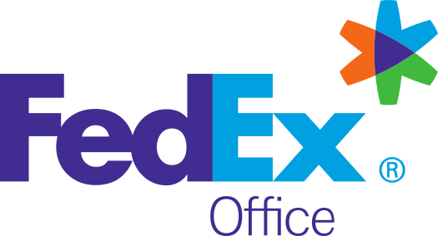
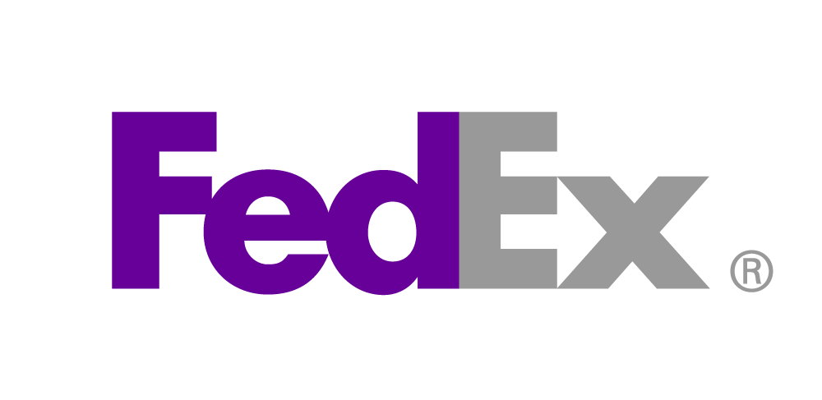

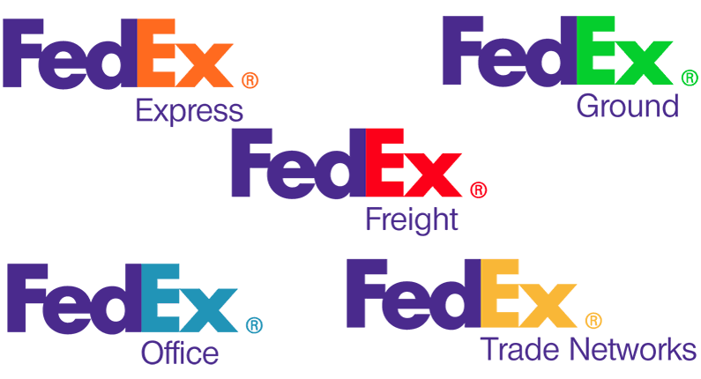


2014
Discover
2015
Implement
2016
Accelerate
2017
Transform

Slide 14

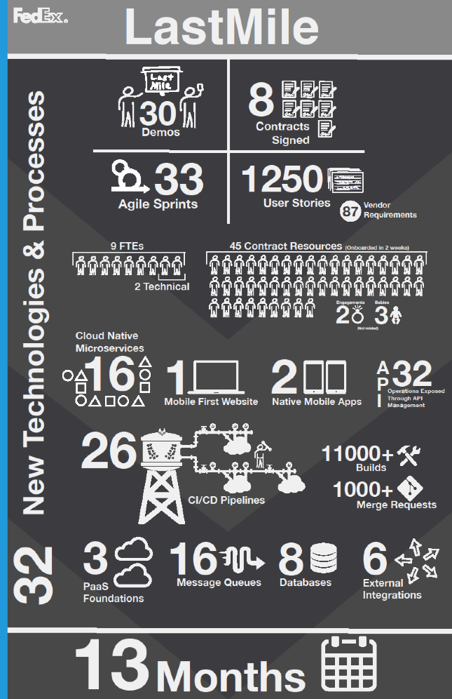

CONTINUOUSLY DELIVER GREAT SOFTWARE
Deliver business results at high velocity by becoming a cloud native software company.
Idea
Learn
Code
Test
Continuous Integration
Deploy
Accept
Build
Credit: Sean Williams, Chris Bochman, Drew Terrell
Notes:
Audience already know they wanna build great sw
This slide speaks to CI/CD + the resiliency afforded by PCF as the answer
Objective = Of course! This sounds fantastic!
OLD NOTES ….
* Stats from The Case for Continuous Delivery by Jez Humble, Feb 2014
So why continuous delivery?
Pivotal CF is at the heart of the solution we’ve been talking about. If a customer is looking to build a next-gen PaaS it is ABSOLUTELY the best platform to do this from an automation, value and openness perspective. PaaS and Pivotal CF on their own offer tremendous operational benefits.
It’s also important to know that you CAN do a lot of the fancy automation I just talked through using a traditional VMware IaaS M&O stack and tools like Puppet or Chef. This direction is less “turn---key” for sure but is recommended path when modernizing to get maximum efficiency from 2nd platform systems.
But let’s talk about Continuous Delivery PLUS Cloud Foundry
<CLICK>
Like I said, surrounding PaaS is a set of integrated tools that automate the SDLC
<CLICK>
When combined these things improve time to market --- you can literally ship code 30 times faster
<CLICK>
Higher quality – 50% fewer failed deployments and the ability to restore services 12x faster
<CLICK>
Reduced cost – 90% lower operational costs thanks to significantly lower headcount requirements
<CLICK>
And finally it delivers early ROI – by getting code out the door sooner and updating more often --- these initiatives tend to pay for themselves very quickly

Slide 15
What’s Next at FedEx?

Slide 16




Cloud Dojo - Accelerate, Agile Everything
CLOUD-WILLING APPS (FAST)
---
OFF-SITE LOCATION
---
DEDICATED RESOURCES
---
PCF ENVIRONMENT
---
PIVOTAL RESOURCES
PAAS
INPUTS
CI/CD
AGILE
TECH OPS, DEV, SEC, Q/A
DATA SVCS
CLOUD NATIVE APPS IN PROD
---
FULLY AUTOMATED CI/CD
---
IT OPS MODEL FOR CLOUD NATIVE APPS
---
ROLES & RESPONSIBILITIES
---
CLOUD ARCHITECTURE PATTERNS
OUTPUTS
<<< CONTINUOUS LEARNING <<<

Slide 17





Cloud Dojo Goals
Define & Automate IT Operating Model for Cloud Native Apps
Automated CI/CD with Cloud Native Certification
Recommendations to Institutionalize the Dojo Way
Effective Collaboration for Global Teams
Meet Compliance Requirements
Notes:
Let you give you a minute to read this slide. Pause for a minute
Does this resemble our reality? Do we lack automated testing, sometimes impacting our customers’ experience? Yup, we experience this a lot right after corporate loads. How much of our time is spent waiting for someone else, just to understand that they were waiting on someone else? The process by which we get our work done involves a lot of waiting – waiting for information from customers, waiting for e-mail replies, waiting for meetings to be scheduled, etc. We also work in very protective silos – where we expect nicely packaged requests that get deposited into a work queue.
Corporate load nights are really, really long aren’t they? There are several reasons for that – couple of which are the lack of automated deployments and checkouts, environment configuration issues etc. And we have postmortems that sometimes breeds lack of trust between groups. And I know that most of you feel the pain of this tug of war between the need for stability and the need to be faster for our business.
We are slow and unreliable compared to the market today – this is not a slight to any group in operations, or development or architecture delivery – it just reflects our history, the burden of our legacy environments and applications. But our customers don’t care that we have this legacy to deal with – they are a fickle lot. They care about innovation, speed, consistency, service, and cost – and they don’t care if it is FedEx that provides the service or UPS or amazon.
So, we must take heed of the cautionary tale of Sun microsystems, and quickly adapt to the changing market, and provide speed and agility that our business needs in order to beat the competition. We need to bring it.
And to do that, we need to change not only our technologies, but also our culture and our processes – not just for the new technologies of IaaS & PaaS, but also for how we get work done for our environment today. That’s where we come in.

Slide 18


Complementary Efforts – Common Target
Initial Focus
Resiliency & CI/CD
(subset of FedEx Cloud Mins)
Desired End State
Cloud Native
(end goal for portability and additional availability gains)
All Apps
Incremental Gains
New Apps and Existing Apps with business justification
FedEx Cloud Mins
(foundational changes to support desired end state)
PH keywords - paas, hackathon

Slide 19
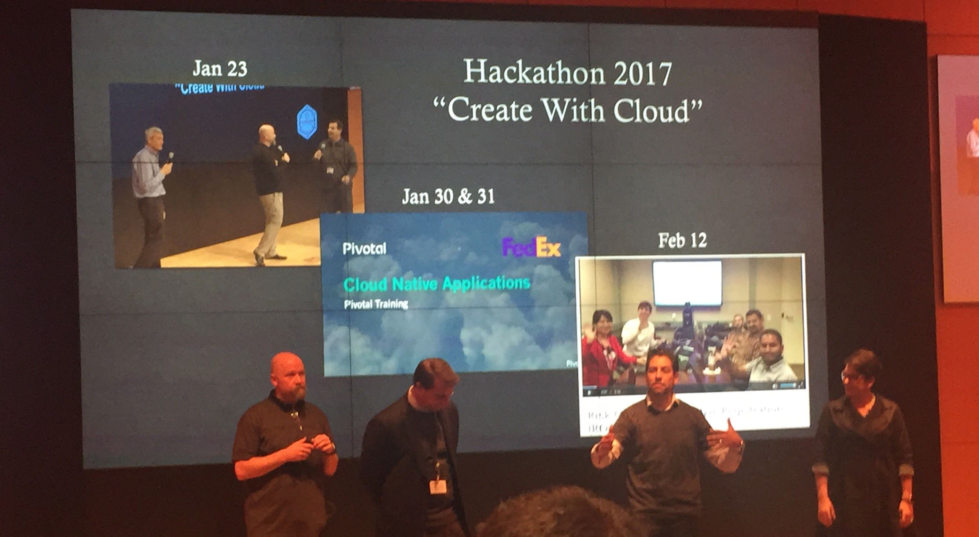
Let’s help you become a disruptor
TOGETHER

Slide 20
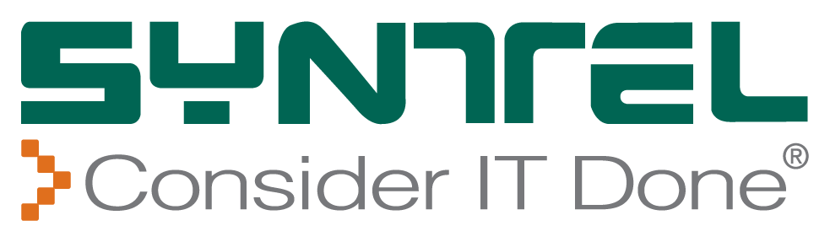
Pivotal
Advanced
Partner

Slide 21
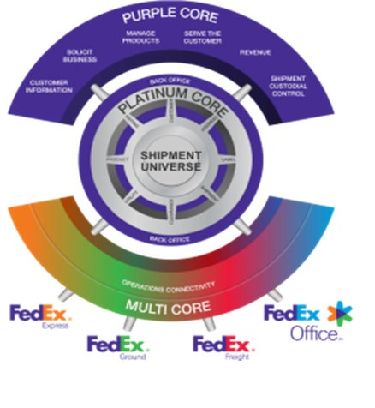
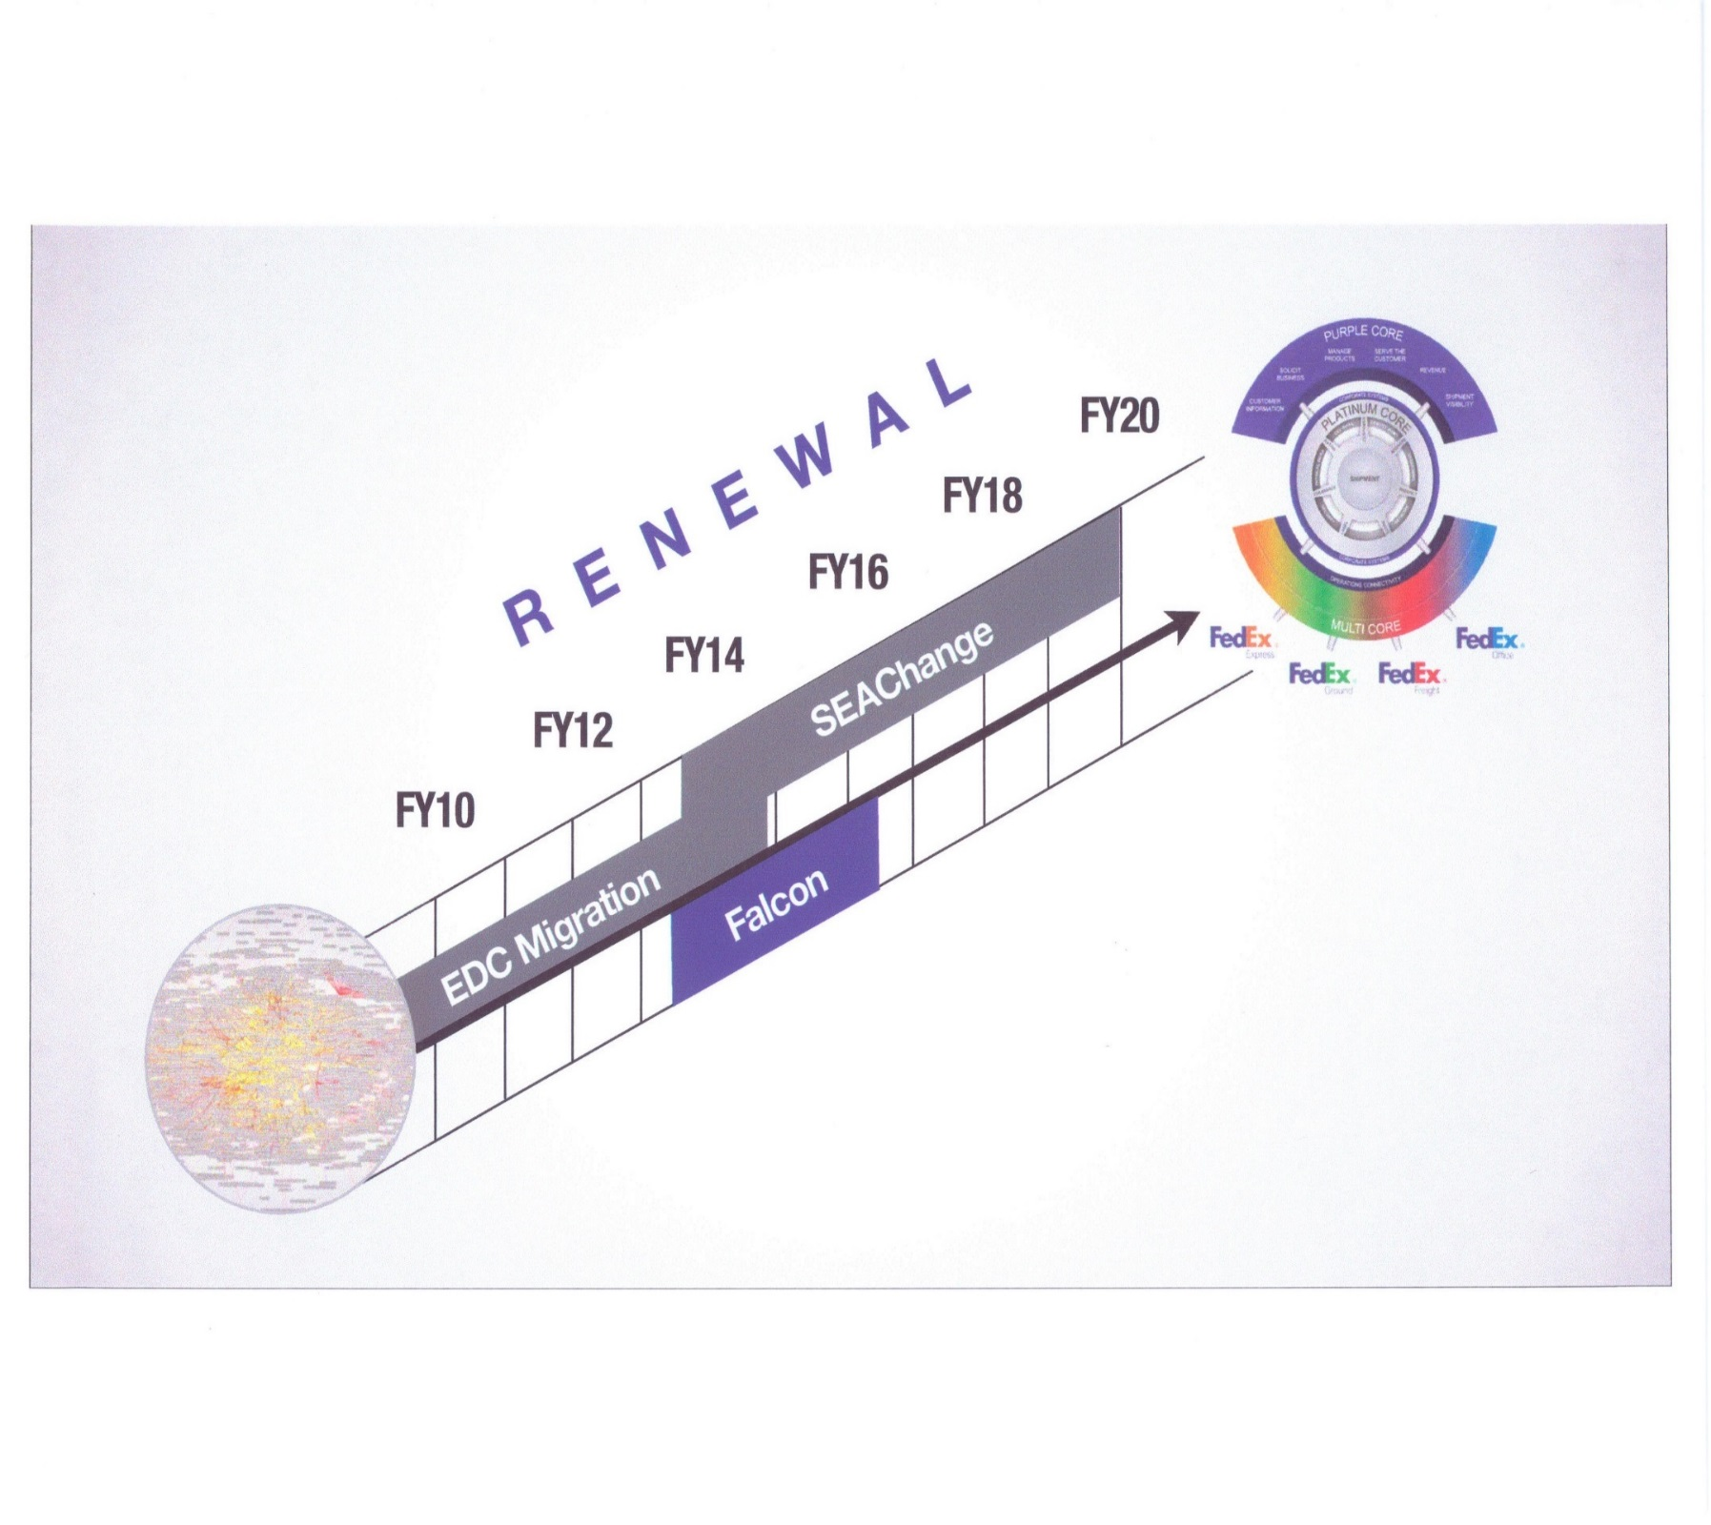
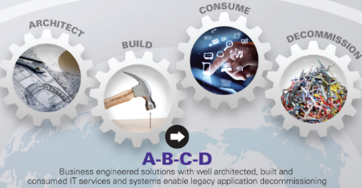

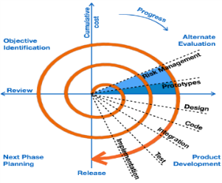
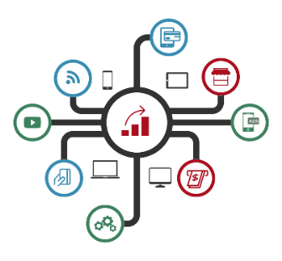
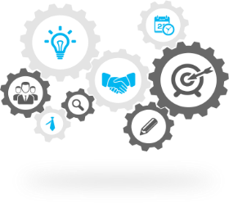

Syntel @ FedEx
DEPARTURE
2009
The FedEx Renewal Journey
END GAME 2020
The SYNTEL Partnership
Infrastructure Rationalization
Development MODEL Transformation
BUILDING THE CORE (ABC)
Digital
Enablement
Business Transformation
FUTURE READY TO HELP FEDEX ACCELERATE “IT MODERNIZATION” & THE ACHIEVE THE “IT STRATEGY”
2012
2013
2014
2016
2017
Achievement of EDC minimums leveraging automated toolsets
CTS to MTS
Onsite to Offshore (1000+) scale
Waterfall to iterative model
Laid the basis for future scale-up
Purple Core: Pricing01, CESE
Platinum Core: CVM, EFS
Multi-core: EPIC, Dim-weight, POL
Mode-2: Mobility
Next-gen CXS’
Active Mainframe modernization engagements (Transcoding, Rewrite, COTS)
YMS
Decommision (D)
Cloudification
Operating Model journey
TNT Integration
GTM Transformation

Slide 22
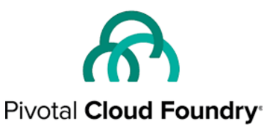
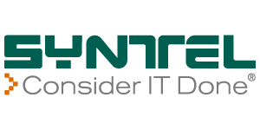
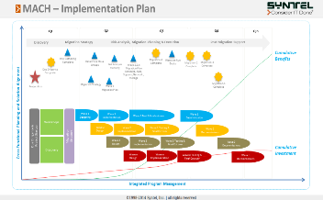
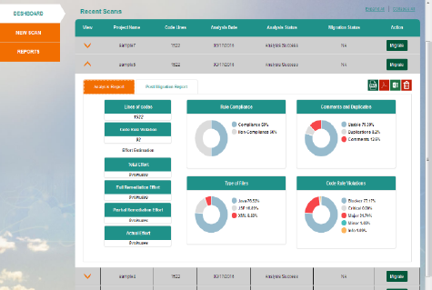
Syntel’s Pivotal Cloud Foundry COE
Advance level Partnership obtained under Pivotal Ready Partner Program
Truly Agile ecosystem facilitating faster time to market
Build Cloud application once and deploy any where
Syntel’s Internal Pivotal CoE setup on Azure Public cloud environment for Pivotal training and certification program
Customer acceleration lab at Memphis dedicated for Fedex
Syntel’s CCAT tool for fast Application Migration from on-prem to PCF with 35% improved productivity
Ready staff of 100+ PCF resources for deployment
29 Cloud Foundry native principles supported in CCAT for Modernization
+
Successful PCF implementation at Fortune 100 Retail Customer
+
Partnership with Azure
+
Best Practice development frameworks across Agile XP, SAFe
+

Slide 23
Thank you.
(we love this stuff)

Slide 24
Appendix

Slide 25
Enabling Next
Generation Agility
Building Great Software (Teams)

Slide 26




FedEx Cloud Mins
These are foundational minimums that can be implemented in most applications regardless of whether the target deployment is a cloud environment. Applications meeting these minimum requirements are NOT necessarily cloud native (see keyword “cloud native” for cloud native principles).
Keyword: cloud mins
No JNDI calls for app container resources
Configuration from environment
Remove file system access
Deploy as JARs and WARs (no EARs)
Remove external classpath references
Leverage Spring Framework
No RMI (i.e. no EJBs)
Resiliency (circuit breakers, timeouts, etc.)
No references to weblogic.jar
Upgrade to Java 8
No dependencies on a specific app container
Automated build and dependency mgmt
Remove app container shared libraries
Adopt Enterprise CI/CD
Do not rely on knowledge of client’s IP address
Self-contained, automated unit tests

Slide 27




AGILE PAIR PROGRAMMING SCALES
EXPERT
NOVICE
3 MONTHS
6 MONTHS
9 MONTHS
1 Year
Notes:
You might say that's fine for TaskRabbit, however, I have a thousand engineers. I have many projects. What about us? What about my software development?
This style of software development scales very well. It can grow very easily, and there's a reason for that. The software method is very, very team based. No single person is responsible for an area of the system. Everybody as a group is responsible for the entire system. The way that that happens is that all of the developers pair programs with each other. This means two software engineers work with one computer together all day. As they work, they teach each other about the different areas of the system. They learn about different areas of the system, and they solve problems. Then the next day, they switch, and they pair up with someone else. What happens is everyone is teaching each other all the time how to build the system, and if you don't know about some area of the system, eventually you will.
There's another interesting thing about this, which is that when you need to absorb someone new into this system of software development, they need to learn all of the rules, all of the discipline of how to do it, and there are a lot of different practices, which I won't go into today because we don't have time, but suffice it to say that there are a lot of things that people need to learn in order to know how to build software like this. When you're pair programming with someone, you find that you learn things very, very quickly. As it turns out, we can measure that. We can measure not only how long it takes someone to learn how to build software this way, but how long it takes them to get to the point where they can teach it to someone new.
In other words, they've become experts enough to assimilate a new person, and that time is about three months. What does this mean? It means that every three months you can double the size of your team. Your novices become experts and then you split the team again and you add in more novices. Three months later, you do it again, and your novices become experts. In this example, we started with two experts and two novices. Well, you could start with four and four or you can start with two teams of eight until you can see that it really doesn't matter how big your organization is if you start with experts who know how to do this and you're training people, you can grow your organization very, very quickly.

Slide 28
The State of Agile Survey
3501 responses collected. 66% from North America, 20% from Europe, the rest from other parts of the world
73%
of respondents cited faster time to completion of projects with agile methodologies
51%
of respondents stated that majority, if not all, of their agile projects have been successful
32%
of respondents cited adopting agile of highest importance is accelerating time to market
92%
of respondents said implementing agile improved their ability to manage changing priorities
87%
of respondents said implementing agile increased productivity
86%
of respondents said implementing agile improved project visibility and improved team morale
Source: www.versionone.com/pdf/2013-state-of-agile-survey.pdf

Slide 29
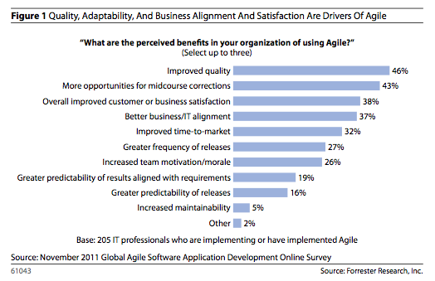
Business Value as Metric for Agile

Slide 30
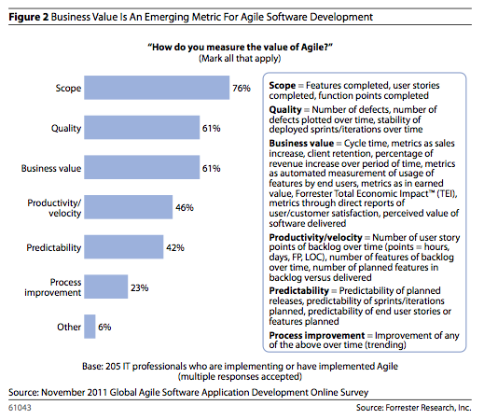
Business Value as Metric for Agile

Slide 31
Studies
Forrester Research conservatively estimates that 38% of businesses, from small to large, now use the development methodology.
http://www.cio.com/article/698811/John_Deere_Plows_Into_Agile?page=1&taxonomyId=3000
Several studies have proven that real business benefits are derived from investing in a more collaborative and agile software delivery process.
http://venturebeat.com/2014/03/10/continuous-delivery/
Double your Productivity, Improve quality by 250%, Cut time to market in half, Balance your team performance.
https://www.rallydev.com/sites/default/files/ImpactAgile_Quantified.pdf
Agile projects are successful three times more often than non-agile projects, according to the CHAOS report from the Standish Group.
http://www.intland.com/blog/agile/agile-vs-waterfall-agile-won-the-game/

Slide 32
Solo vs. Pair Programming
 | Solo | Pair
Efficiency (decimal percent) | 0.17 | 0.34
New-code productivity (LOC/person-hour) | 25 | 22
Overall productivity (LOC/person-hour) | 4.3 | 7.4
LOC = Lines of Code
Empirical results show that pairs produce higher quality code, more efficiently, and with higher overall productivity.
Source: Williams, Laurie, and Robert R. Kessler. Pair Programming Illuminated. Boston: Addison-Wesley, 2003. Print.

Slide 33
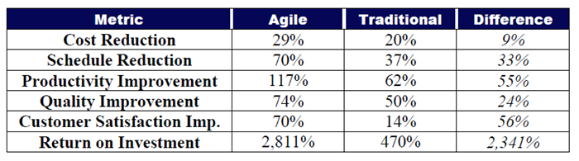
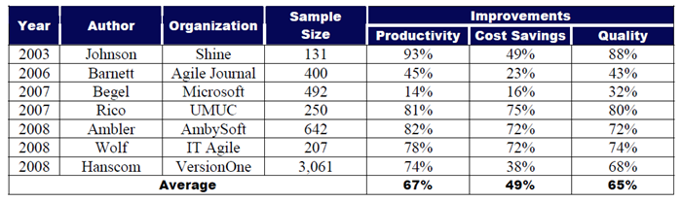
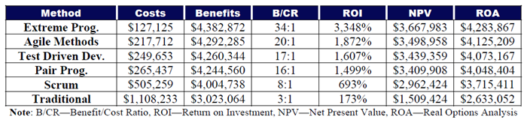
ROI Example: XP vs. Waterfall or Agile
Source: http://davidfrico.com/rico-apm-roi.pdf

Slide 34
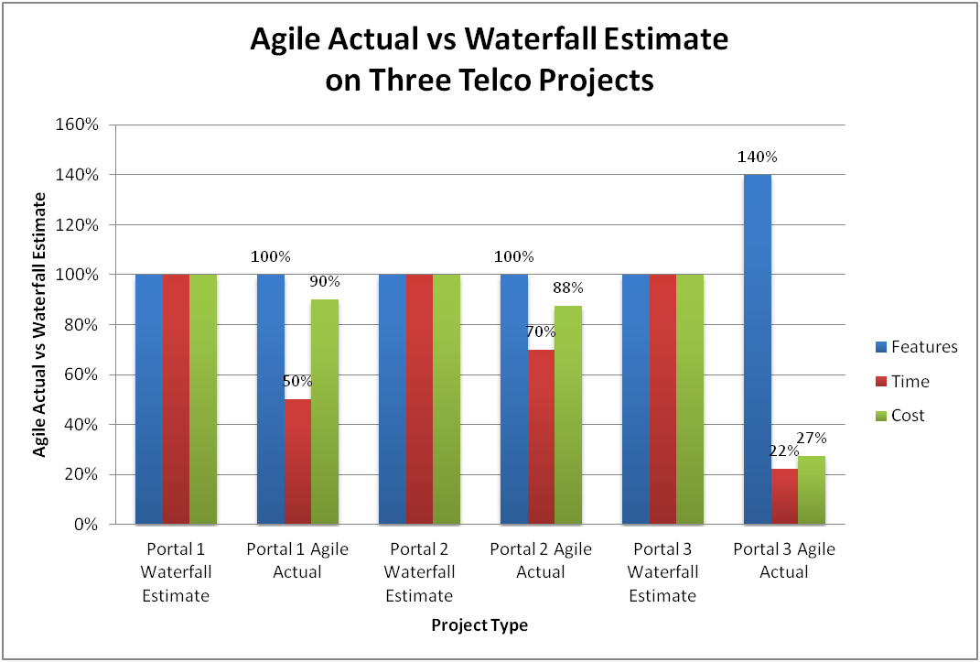
ROI Example: XP vs. Waterfall or Agile

Slide 35
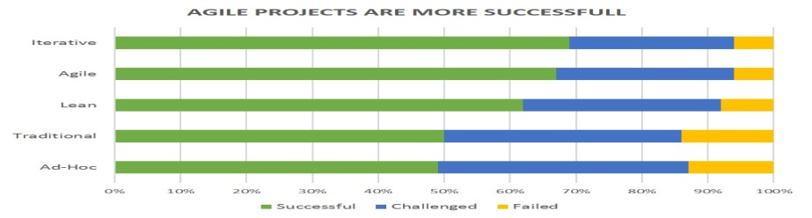
ROI Example: XP vs. Waterfall or Agile

Slide 36



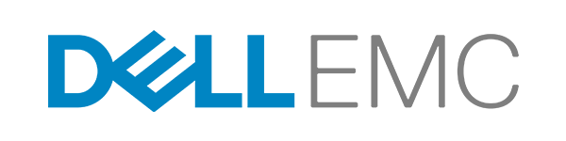

Pivotal Investors

Slide 37
Thank You!

